Slide 1
Safe Powerboat Handling
Classroom Session One
Powerpoint 2 of 2

Slide 2
Engine Information
Outboards
Engine mounted on transom of boat
2hp – 350+ hp
2-stroke or 4-stroke
2-strokes fire once every revolution of the crankshaft
Power / intake-exhaust; compression
4-strokes fire once every 2 revolutions of the crankshaft
Intake – compression – power - exhaust
2-strokes use a gas/oil mixture
4-strokes use straight gas (oil is in the crankcase)
Traditional 2-strokes are becoming obsolete
Bad for the environment
Less fuel efficient
SPR p.13

Slide 3
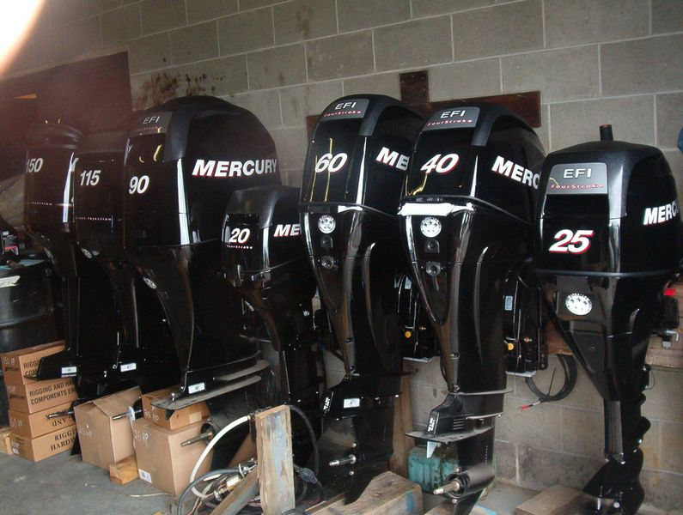
Engine Information
Outboards
Variable shaft lengths
Can be tilted all the way up or removed for storage
Parts of an outboard engine p.14

Slide 4
Engine Information
Inboards
Engine mounted inside boat
Gasoline or diesel
Diesel is safer than gas – less risk for fire
Gas inboards MUST have a backfire flame arrestor
3 types of drive options:
Fixed propeller drives
Prop shaft passes through bottom of boat
Steered by a rudder
Stern drive (I/O)
Engine mounted inside and the power train goes through transom to the stern drive
Stern drive has tilt and trim similar to an outboard
Jet drive
Impeller accelerates water through a nozzle to produce propulsive thrust
SPR p.20

Slide 5
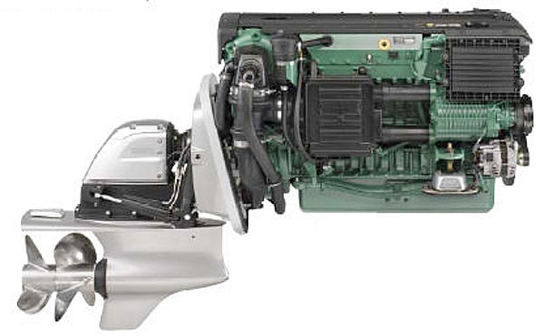
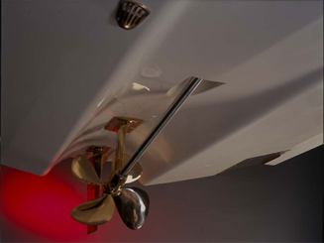
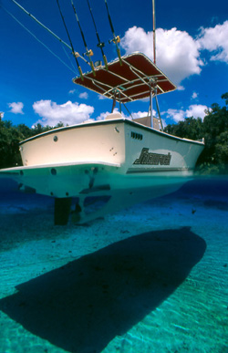
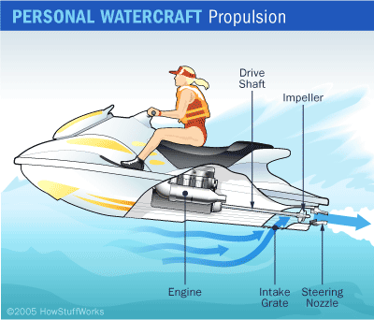
Engine Information
SPR p.20

Slide 6
Engine Information
Proper fueling procedures
Common fueling mistakes
Forget to vent the jerry can
Nozzle not tightly attached to jerry can
Overfilling
Pouring one tank straight into another without a funnel or nozzle
Pouring fuel into a deck fill that is NOT for fuel
SPR p.18, 25

Slide 7
Engine Information
Proper start-up procedures for gas engines
Inspect all hoses and wires
Check fuel, oil and transmission fluid levels
Run blower for 4 min (inboards)
Lower engine into water (outboards and I/Os)
Open vent, pump fuel primer bulb until firm
Ensure that gear shift is in neutral
Attach stop switch (kill switch)
Pull cord / turn key to start
Use choke and adjust idle as needed until running smoothly
Once running, MAKE SURE THERE IS A STREAM OF WATER FLOWING FROM THE INSPECTION OUTLET
Check gauges
SPR p.16, 21

Slide 8
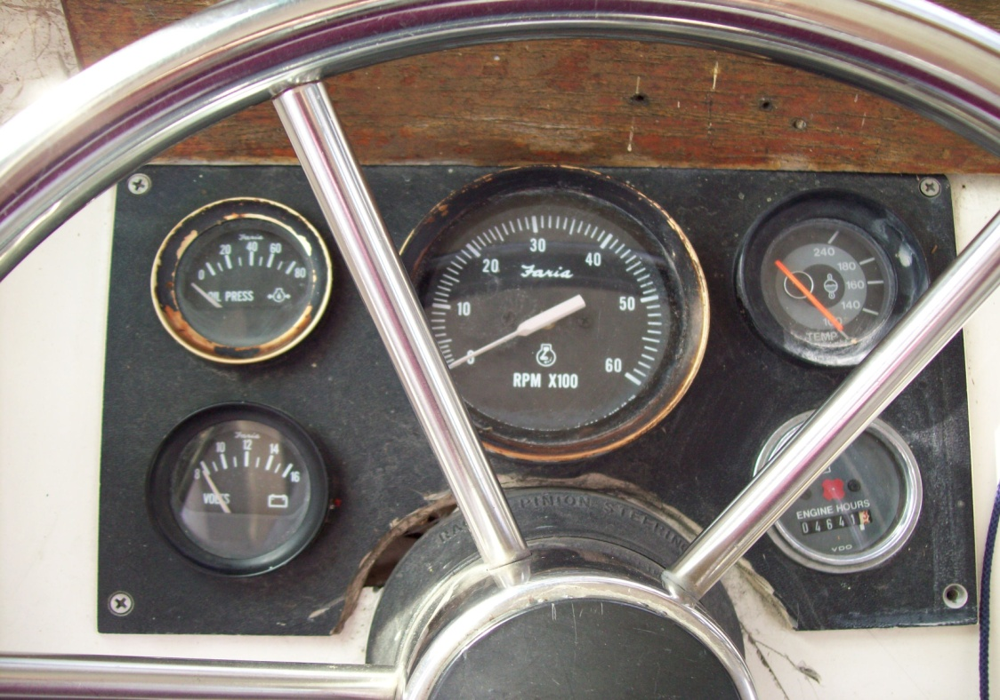
Engine Information
Gauge Guidelines
Hour Meter
Volt Meter
12+ volts
Oil Pressure
MINIMUM of 20 PSI
RPM –
MAX Idle RPM of 800
Temperature
140-160 is normal; 180+ is overheating

Slide 9
Engine Information
Troubleshooting
Fuel – Spark – Compression!
Nothing happens when you turn the key
Spark – is the battery dead? Are you in neutral?
Engine turns over but won’t catch
Fuel – is the engine getting gas? Is there water in the gas? Is the fuel line attached backwards?
STOP SWITCH!
Engine runs fine at idle but kills when at higher RPM
Spark – bad spark plug? Loose spark plug lead?

Slide 10
Pre-Boarding Preparation
Check weather conditions
Not just for today but for yesterday and tomorrow!
Internet
Weather.com
Sailflow.com
Intellicast.com
NOAA.gov
VHF
WX channels – broadcast continual marine forecasts
SPR p.29

Slide 11
Pre-Boarding Preparation
Check tides and currents
Occasional current in mouths of harbors depending on wave/swell direction
To check current, use a current stick or observe motion of water around a fixed object

Slide 12
Pre-Boarding Preparation
File a Float Plan!
SPR p. 31

Slide 13
Pre-Boarding Preparation
Complete Vessel Checklist
Example Checklist: Chicago Yacht Club

Slide 14
BREAK

Slide 15
Boat Operation
Proper boat storage – At the dock
Engine raised and flushed (well….maybe)
Steering wheel turned so steering arm is enclosed
Lines checked and flemished
Fenders hung at proper height
Battery switched off (if appropriate)
Any gear that was used stowed appropriately
Bilge checked
Garbage emptied

Slide 16
Boat Operation
Proper boat storage – Ashore
Trailer guidelines
Be diligent with checking all aspects of trailer and connection
Don’t settle – if boat isn’t seated properly, redo it
Always remember to raise your engine before driving up the ramp!
Check your tie downs multiple times.
SPR p.143

Slide 17
Knots
www.animatedknots.com
Cleat hitch
Bowline
Round turn w/2 half hitches
Sheet bend
Coiling and heaving
SPR p.35

Slide 18
REVIEW QUESTIONS

