Slide 1
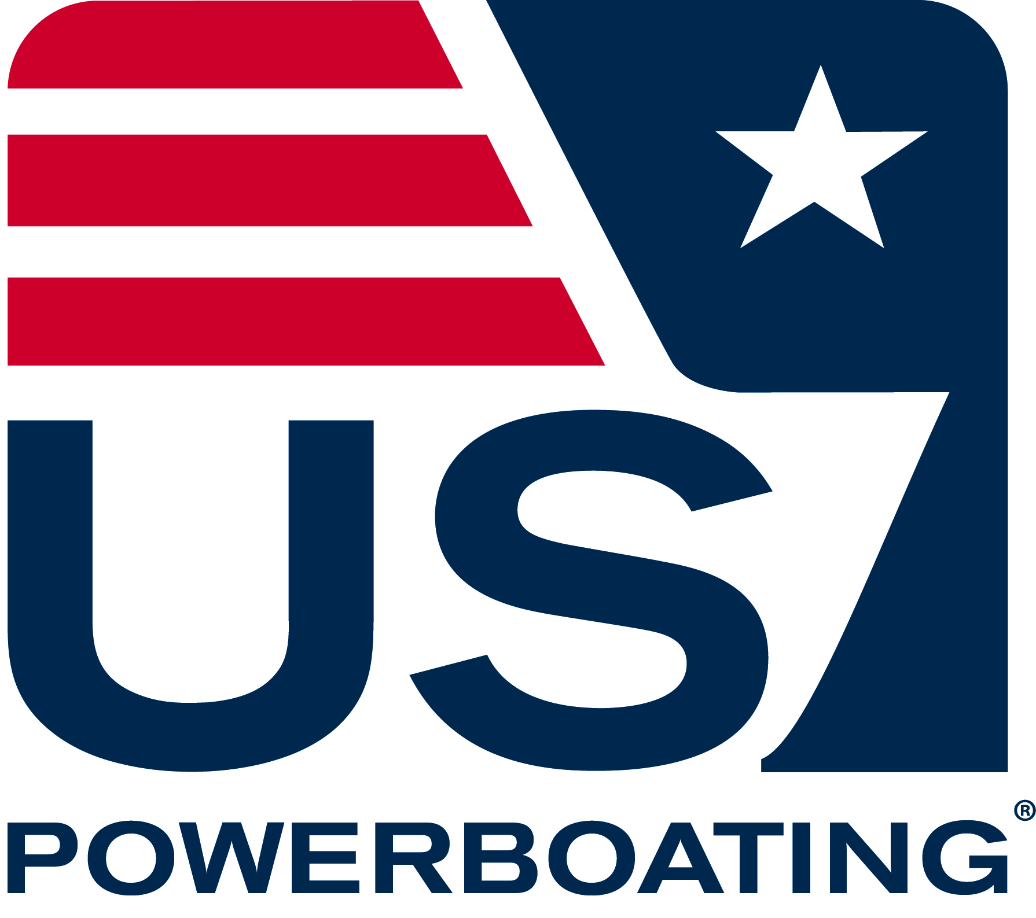
Safe Powerboat Handling
US Powerboating
Classroom Session One
Powerpoint 1 of 2

Slide 2
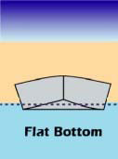
Hull Types & Characteristics
Flat Hulls [SPR p.4]
Easily get on a plane at high speeds
Designed for calm, flat water
Not very stable
Excessive slide when maneuvering

Slide 3
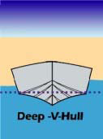
Hull Types & Characteristics
Deep V [SPR p.5]
Similar to flat bottom, but designed to cut through water
Good steering ability at high speeds
Perform well in waves in speed; tend to roll at rest

Slide 4
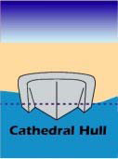
Hull Types & Characteristics
Cathedral Hull [SPR p.5]
Two or three v-shapes forward, flat in back
Good stability at rest and speed
Rough in speed in waves
Usually have lower freeboard

Slide 5
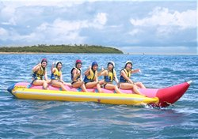
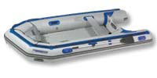
Hull Types & Characteristics
Soft-Inflatable Hull [SPR p.5]
Poor driving ability (excessive slide)
High stability
High load capacity
Very wet ride

Slide 6
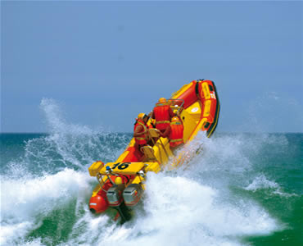
Hull Types & Characteristics
Rigid-Inflatable Hull [SPR p.4]
Rigid v-bottom
High stability
High load capacity
Exceptional seaworthiness in rough weather

Slide 7
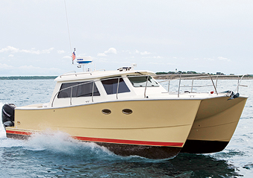
Hull Types & Characteristics
Multi-Hulls [SPR p.6]
Resist rolling
Good steering ability at speed
Large turning radius
Shallow draft

Slide 8
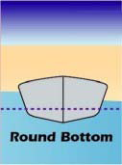
Hull Types & Characteristics
Round Bottom [SPR p.4]
Displacement hull
Glide through water efficiently
Usually have keel or chine for stability
Good load bearing capability

Slide 9
Parts of the Boat
SPR p.11

Slide 10
Propellers
How propellers work
Thrust
Rotation [right-screw most popular]
Side force (prop walk)
More noticeable in reverse – esp. on fixed propeller
Diameter
Pitch
Distance propeller would move in one revolution if turning in solid material
ie 17” pitch propeller would move 17” inches
Propeller size = diameter + pitch
Smaller diameter + higher pitch used on high-speed boats
Larger diameter + lower pitch used on slow-speed boats
Stainless steel vs. Aluminum
Linkage p.16
SPR p.8

Slide 11
Maneuvering Concepts
Uncontrollable forces affecting a boat
Wind p.44
Windage causes bow to fall off and boat to drift sideways
Increased freeboard = increase windage effect
Windage affects your turning arc
Current
Will move boat along as if on a conveyor belt
Size, shape, etc. do not matter – current effects all things equally
SPR p.44

Slide 12
Maneuvering Concepts
How Boats Turn
Directed Thrust p.41
Outboards, stern drives and jet drives
When a propeller is turned at an angle, its thrust is directed at an angle, which turns the boat
If propeller is not rotating then no thrust, so no steerage
Rudder p.41
Boats with a fixed propeller use a rudder to direct the flow of water
Water flowing over the rudder creates lift (sideways force) and turns the boat
No water flowing over the rudder = no steerage
Pivot Point p.44
In forward, a boats pivot point is located 25% to 40% aft from the bow
Always steer the pivot point along the path you want to steer!
Where is the pivot point on a boat in reverse?
SPR p.41, 44

Slide 13
Maneuvering Concepts
Planing hulls behave like displacement hulls at low speed
At a certain speed, the hull goes through a transition stage called semi-displacement as it climbs the face of its bow wave p.47
Once the boat moves over the top of its bow wave, it levels off and begins to plane
Q: Where is the most optimum fuel consumption for a planing hull?
SPR p.47

Slide 14
Safety Equipment: Lifejackets
Type I – Offshore Life jacket
22 lbs of buoyancy for adults / 11 lbs for children
Will turn unconscious person face-up
Type II – Near-Shore Life Vest
Min. of 15.5 lbs for adults / 11 lbs for children
Will turn some unconscious people face-up
Type III – Flotation Aid
Buoyancy the same as Type II
Will not turn unconscious person face-up
Most common
Type IV – Throwable Device
Type V – Special use Devices
Inflatable vests, etc.
No inherent buoyancy
Must be worn!
SPR p.83

Slide 15
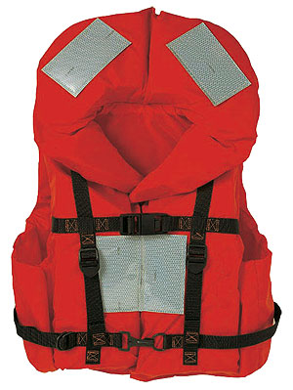
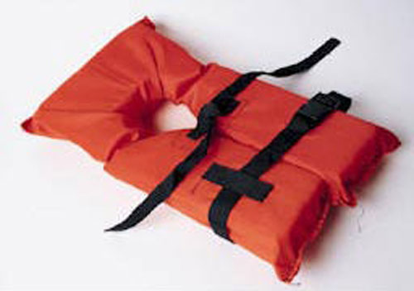
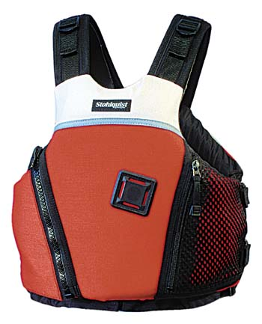
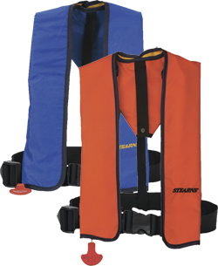
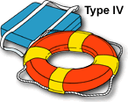
Safety Equipment: Lifejackets

Slide 16
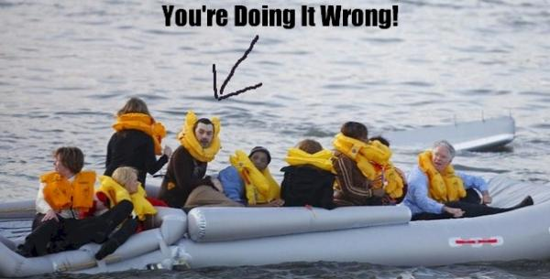
Safety Equipment: Lifejackets
Lifejackets
Proper use of PFDs is integral!
Should fit snugly but still allow movement
If you can pull it up around your head on land, the same thing will happen in the water
Any PFD with a tear or hole in it is no longer Coast Guard approved

Slide 17
Safety Equipment
Federal Requirements for boats under 26ft
One life jacket for each person on board. Must be readily available.
Children under 13 MUST wear a lifejacket while underway (on any size vessel) unless below decks or in an enclosed cabin
Over 16ft – one Type IV throwable device
Sound producing device p.85
Air horn, whistle, manual horn, etc.
Fire extinguisher p.85
Under 26ft – one B-I
A – combustible material (wood)
B – flammable liquids (gas)
C – electrical (wiring)
D – combustible metals (magnesium)
Under 16ft - Visual distress signals if used at night p.84
16ft up – MUST carry approved day/night visual distress signals
SPR p.85

Slide 18
Safety Equipment
Recommended Requirements
Anchor + rode
VHF Radio
Knife
First Aid Kit
Spare parts / tool kit
Oars
Hand bilge pump
Tow line / spare line

Slide 19
Registration Information
Hull Identification Number
Registration numbers and form
Boat must be registered in its state of principal use or federally documented
‘IL’ numbers must be displayed on each side of the bow in letters at least 3” high
Registration must be aboard vessel at all times
Max capacity plate
Displays maximum weight and # of passengers (# of passengers takes precedence)
Displays maximum horsepower engine (on outboard)
Displays maximum weight capacity of all passengers, engine and gear
Capacity equation: L x B / 15
SPR p.82

Slide 20
State Specific Information
INSTRUCTORS: Use this section to include specific information for the state in which you will be teaching Safe Powerboat Handling.
Examples: Marine Heads, Pollution Laws, Age of Operator, etc.

Slide 21
BREAK

