Slide 1
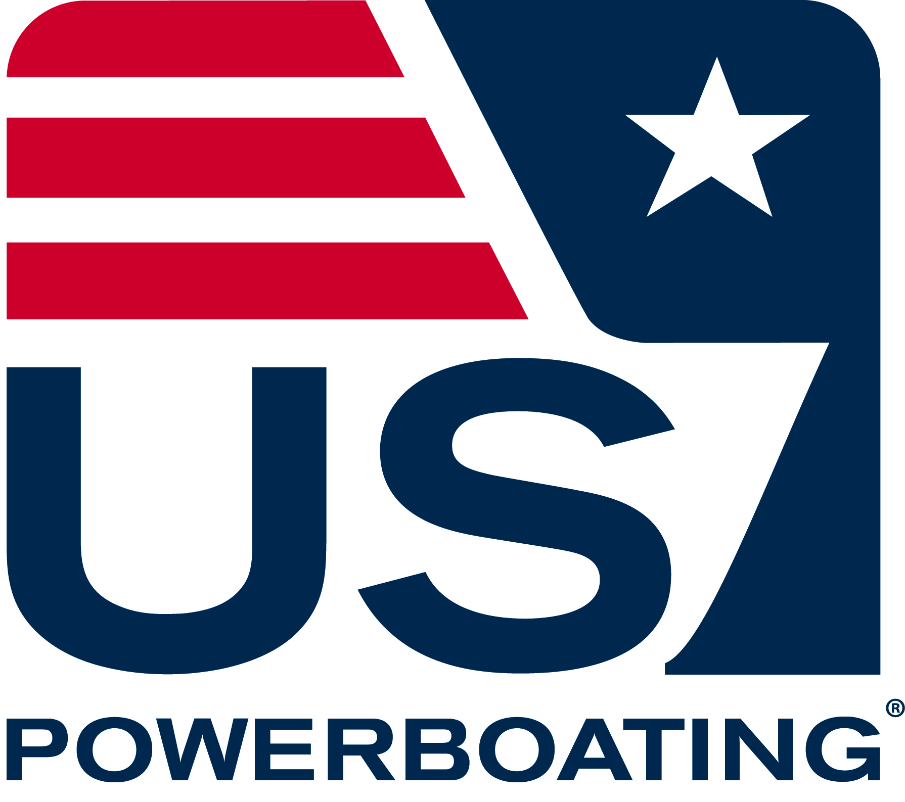
US Powerboating Safe Powerboat Handling / Safety and Rescue Boat Handling Day Two

Slide 2
Navigation Rules
Rules of the Road SPR p.107
Inland Rules vs International
Maintain proper lookout
Safe speed
Operating in narrow channels
Vessels less than 20m SHALL NOT impede passage of a vessel that can only operate in the channel
A vessel engaged in fishing (NOT trolling) shall not impede the passage of any other vessel
On rivers (Inland Rules): vessels proceeding downbound (w/the current) shall have right-of-way over an upbound vessel
Sounds signals
Can provide information such as which side you are passing on, to indicate danger or confusion or as an alert in fog

Slide 3
Navigation Rules
Rules of the Road
Rule 2 of the Navigation Rules
“Nothing in these Rules shall exonerate any vessel, or the owner, master or crew thereof, from the consequences of any neglect to comply with these rules…or by the special circumstances of the case.”
Rule 7 of the Navigation Rules
“Every vessel shall use all available means appropriate to the prevailing circumstances and conditions to determine if risk of collision exists. If there is any doubt such risk shall be deemed to exist.

Slide 4
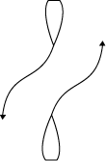
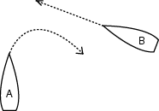
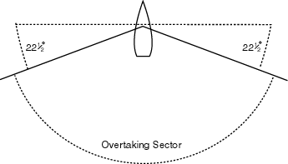
Navigation Rules
Rules of the Road SPR p.109, 110
Head on
Starboard over Port
Overtaken over Overtaking (Clear ahead over clear astern)
Sail over Power (unless in a channel)

Slide 5
Navigation Rules
Rules of the Road
Vessels underway must always keep clear of:
A vessel not under command (ie. Adrift or on fire)
A vessel that is restricted in its ability to maneuver (ie. Dredging)
A vessel engaged in fishing with nets, lines or trawls
DOES NOT include fishing with trolling lines
Remember – the stand on vessel has the right way, the give way vessel must alter her course
A formal accident report must be submitted within 48 hours if a person dies, there are injuries requiring more than first aid or if there is more than $2000 in damage. SPR p.90

Slide 6
Navigation Rules
Rules of the Road – Right Away Rules
Only Overtaken
New Not under command
Reels Restricted in its ability to maneuver
Catch Constrained by draft
Fish Fishing
So Sailing
Purchase Power driven vessel
Some Seaplane
Worms WIG

Slide 7
Navigation Rules
Rules of the Road
Light schemes
Masthead light = white light 225° fixed to show light from right ahead to 22.5° abaft the beam on either side
Sidelights = 112.5° green light on the starboard side and a 112.5° red light on the port side fixed to show light from right ahead to 22.5° abaft the beam
Sternlight = 135° white light placed near or at the stern fixed to show the light 67.5° from right aft on each side of the vessel
All-round light = 360° light

Slide 8
Navigation Rules
Rules of the Road
Light schemes
Power driven vessels less than 12 meters in length must exhibit a masthead light, sidelights and sternlight while underway
An all-round white light may be substituted for the masthead light and sternlight
Vessels under sail must exhibit sidelights and a sternlight
Vessels less than 50 meters at anchor must exhibit an all-round white light where it can best be seen

Slide 9
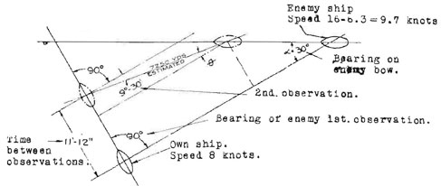
Navigation Rules
Rules of the Road SPR p.108
How to determine if risk of collision exists (handout):
Constant Bearing Decreasing Distance
When In Doubt, risk is assumed to exist!

Slide 10
Navigation Rules
Rules of the Road
What is bearing drift? (handout)
Bearing taken relative to you or your boat

Slide 11
Navigation Aids
Aids to Navigation SPR p.120 and CD
Lateral Marks – system of lateral marks used to indicate on which side a mark should be passed when returning from seaward
In US waters, red marks are kept on the starboard side; green marks are kept on the port side
When an approach from seaward cannot be determined, the Conventional Direction is used, which is a clockwise rotation around the US.
On Lake Michigan, a southerly direction is considered returning from sea
RED AND GREEN MARKS
PORT LATERAL MARKS will be green, odd numbered cans or squares
STARBOARD LATERAL MARKS will be red, even numbered nuns or triangles
PREFERRED CHANNEL MARKS will be red and green banded and can be any of the above shapes (nuns, cans, squares or triangles)
ALL MARKS can be daymarks, bouys, lit or unlit, flashing or solid, with sound or without
Other marks include safe water marks, isolated danger marks, special purpose marks and information/regulatory marks
Your chart will indicate the type of mark you are expecting

Slide 12
Navigation Aids
Aids to Navigation SPR p.120 and CD
Some tricks:
Red – Right – Returning // Green – Going – Out
Retuning from sea – clockwise direction around the US
Entering a harbor is always ‘returning from sea’
7-UP = green can with odd number
On the ICW, yellow triangles indicate shoreward side of channel and squares indicate the seaward side. Think triangles for mountains

Slide 13
Navigation and Piloting SPR p.112
Parallels of Latitude (0-90 north and 0-90 south of Equator)
Meridians of Longitude (0-180 west and 0-180 east of Greenwich)
Latitude and Longitude
Measured in degrees, minutes and seconds
Many charts use decimals of degrees and minutes (they do not include seconds)
60 sec = 1 min = 1 nautical mile
60 min = 1 degree
Every 15 degrees = one time zone (360° / 24hrs = 15°)
ALWAYS measure distance on the LAT scale
Preciseness is key

Slide 14
Navigation
Compass SPR p.118
Variation – difference in degrees between your compass readings and true north
Changes with location
Deviation - difference in compass readings created y their magnetic influence
Compass Error = sum of variation and deviation expressed in degrees E or W
ex. If, for your onboard compass and location, variation = 9°W and deviation = 4°E then CE = 5°W
SO, if the true course on the map was 054°, you would steer 059° with your onboard compass
GPS is always TRUE!

Slide 15
Navigation
Charting tools:
Parallel rules
Dividers
Drawing compass
Drawing triangles

Slide 16
Navigation
Ranges SPR p.132
Tides SPR p.105 and SRS Supplement

Slide 17
Capsize Recovery Methods
Page 17-35 SRS
2 types of capsized vessels
Surface capsize and turtle
Approach vessel slowly from downwind towards the mast.
Make sure you can see all sailors before you get too close.
Assist as requested.
Potential challenges
Mast stuck in mud, wrapped lines, cleated sails, sailor caught in lines or underneath boat, etc.
Let’s review the section in the book…

Slide 18
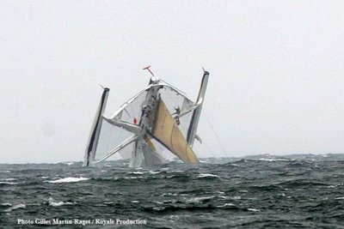
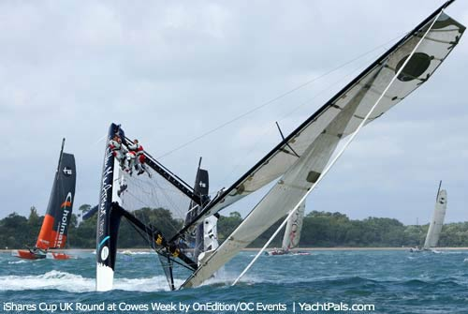
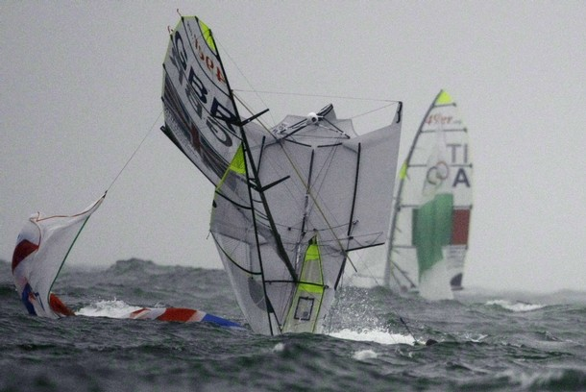
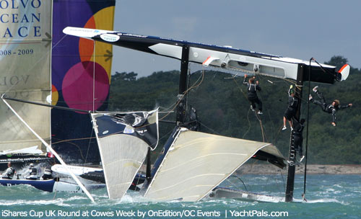
Capsize Recovery Methods

Slide 19
Towing
Page 47-52 SRS and p.142 SPR
Five Types of towing methods
Single-line
Pram variation
Double-line
Herringbone Tow
Towing alongside
COMMUNICATION IS KEY!

Slide 20
Towing
Use proper driving technique while towing
Accelerate and decelerate at a constant rate to avoid jerking or severe line slack.
Make sure to inform the towed vessel driver to steer at your transom (avoid the waterskier effect).
Mainsails should be lowered BEFORE you pick up the sailboat.
In any kind of breeze it is dangerous to tow a boat with the mainsail up in any direction but directly upwind.
If you are towing multiple boats and one falls off the tow, maintain tension for the remaining boats and circle around to pick them up.

Slide 21
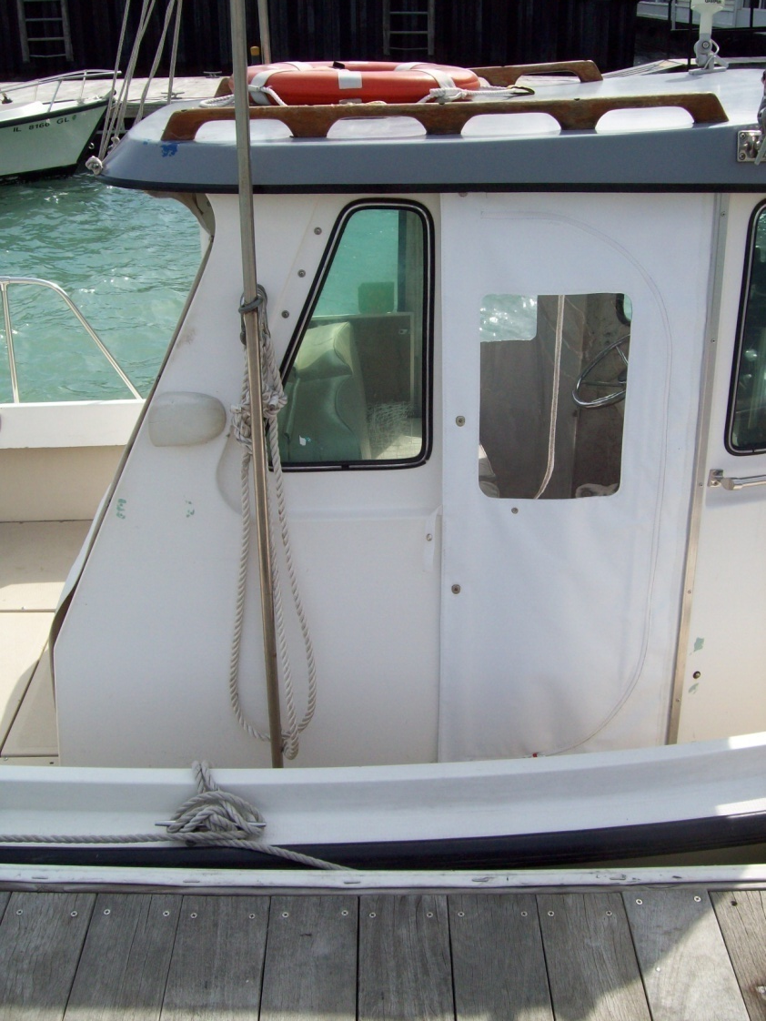
Towing - CYC
Prep the boat before you get there.
Radio boat to be assisted and make sure they have a proper towing line.
Line should be tied around the mast of the sailboat. (or the bow cleat**)
Attach bridle.
Approach sailboat from downwind
Keep an appropriate distance – factor in wind and waves.

Slide 22
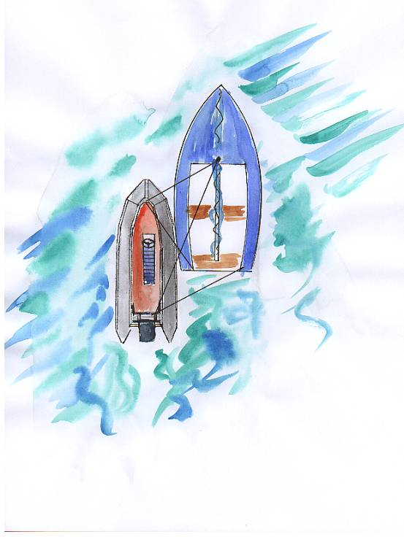
Towing
Alongside tow

Slide 23
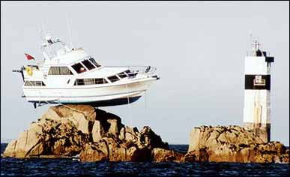
BREAK

Slide 24
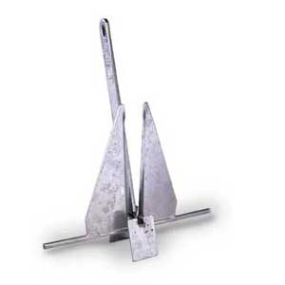
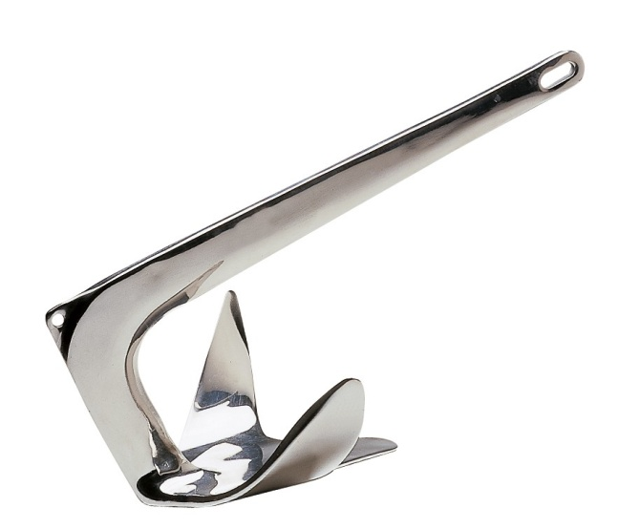
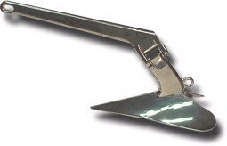
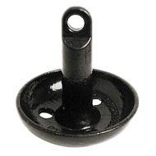
Anchoring SPR p.71
Types of anchors
Danforth-type
Bruce
Plow
Mushroom
Rode = anchor line
Scope = length of rode / (water depth + freeboard)
5:1 for lunch; 7:1 or more for extended stays or strong winds/seas
Setting and retrieving an anchor – let’s look at pages 73-75

Slide 25
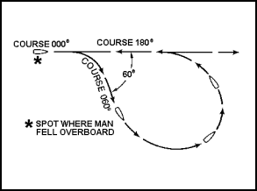
Emergency Procedures
Conducting a Search (SRS Supp. p. 8-12)
Item in sight
Mark position w/ GPS or Loran and throw visible flotation
Proceed with PIW recovery
Item is not in sight but incident was recent
Mark position w/ GPS or Loran
Commence modified Williamson Turn
Assign visual search sectors to passengers
Scan using regularly spaced eye movements
If loss involves human life, place a Mayday or Pan-Pan
If no luck, return to estimated position of loss and set up a search pattern

Slide 26
Emergency Procedures
Conducting a Search (SRS Supp. p. 8-12)
Item is not in sight and incident is not recent
Set up a search pattern
Datum = anchor of pattern
Types of search patterns:
Expanding square search
Parallel track search
Along track ladder search
Sector search (multiple and single units)

Slide 27
VHF Protocol and Usage
Page 4 SRS
Channels:
16 – Emergencies, hailing
09 – Recreational hailing
22 – Coast Guard
VHF channels are monitored by the USCG, Chicago Marine Police and others
It is against the law to use these channels improperly
They can find you!

Slide 28
VHF Protocol and Usage
Securite
Pan-Pan
Mayday

Slide 29
VHF Protocol and Usage
How to operate (demo)
Things to remember
Position VHF perpendicular to the wind or directly downwind
The Hi/Lo function ONLY affects your transmitting power – it does not increase your receiving power
The antenna is most effective held straight up and down as high as you can hold it
Wait a second after depressing the call button before speaking (it will save people a lot of frustration)
BE SUCCINCT! It is not a telephone. Have a point and get to it quickly.

Slide 30
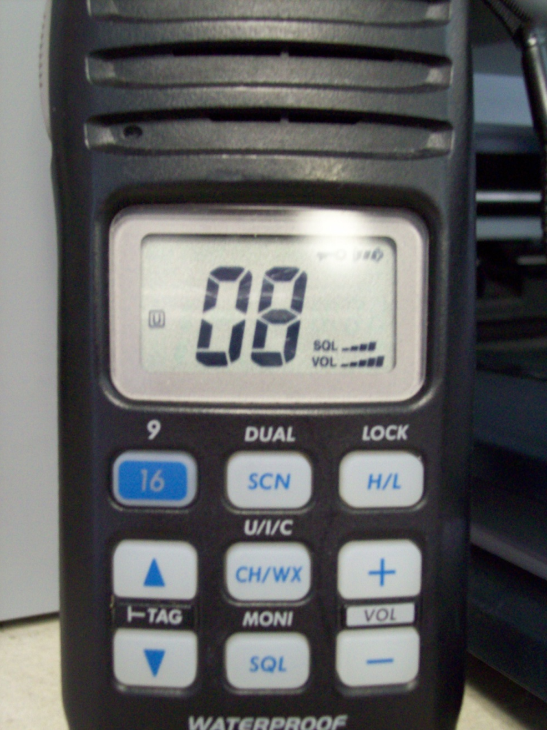
VHF Protocol and Usage
Proper radio protocol
16/9 Channel
Channels
Tag
Squelch
Volume
Scan
Dual
H/L
Lock
CH/WX
U/I/C

Slide 31
Boat Operation
Steering a range (inbound and outbound)
Position relative to moving vessel
Boat handling in adverse weather conditions
Capsize boat recovery

Slide 32
Knots
Quick release
Bowline on a bight
Bowline w/half-hitch
Rolling hitch
Towing bridle

Slide 33
REVIEW QUESTIONS

Slide 34
LUNCH

